Slide 1
GENDER DETECTION IN A PHOTOGRAPH
Guided By:
Mrs. E. Sirisha,
Assistant Professor
Batch members:
R. Sai Sravanthi (13131A0585)
C.S.U Sampreeth (13131A0594)
Y. Tirumala Sai Prasad (13131A05B8)
P. Vinay Kumar (14135A0520)

Slide 2
ABSTRACT
The project's main aim is to detect the gender based on the face detection, if humans. This reflects the count of males and females in a photograph presented to us. Firstly, we detect the face using Viola Jones algorithm which has been successfully implemented in many a one application. Then, we identify faces in a group image. Secondly, we pass the detected parts of image to the gender detection algorithm which is implemented using "back propagation". Finally, we can get the count of males and females in the photograph. We are developing this project using MATLAB and Python technologies.

Slide 3
LITERATURE SURVEY
The idea is based on gender detection in a photograph containing a single person published by :
Anushri Jaswante et al, / (IJCSIT) International Journal of Computer Science and Information Technologies, Vol. 4 (6) , 2013 :
“Gender Classification Technique Based on Facial Features using Neural Network”
The steps involved in the process are :
Face detection
Feature extraction
Gender classification

Slide 4
EXISTING SYSTEM
Till now, there is availability for detecting faces in a photograph
There is availability for detecting the gender in an image containing single human face

Slide 5
PROPOSED SYSTEM
A photograph containing group of people is given as input
The system will be able to detect the gender of all the persons in the group contained in the photograph
ADVANTAGE:
Using this system, we can know the strength of the persons in a classroom and based on gender we can know the count of males and females too.

Slide 6
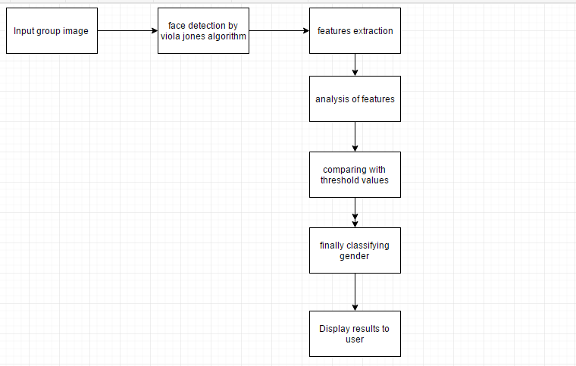
Proposed System Architecture

Slide 7
REQUIREMENTS
REQUIRED HARDWARE:
System : Dual Core or Higher Processor having clock speed 2.0 GHz or higher
Hard Disk : 30-100 GB of Hard Disks
Mouse : Optical Mouse
Ram : 1 GB or above
REQUIRED SOFTWARE:
Operating system : PC Running Windows XP or Earlier Versions
Coding Language : MATLAB, Python.

Slide 8
ALGORITHM
Viola Jones Algorithm for Face Detection:
The algorithm has four stages
Haar Feature Selection
Creating an Integral Image
Adaboost Training
Cascading Classifiers
Feature Extraction
Gender classification

Slide 9
CODE
For detecting faces:
faceDetector = vision.CascadeObjectDetector;
faceDetector.MergeThreshold=10;
I = (imread('E:\pics\25.jpg'));
bboxes = step(faceDetector, I);
IFaces = insertObjectAnnotation(I, 'rectangle', bboxes, 'Face');
figure, imshow(IFaces), title('Detected faces');

Slide 10
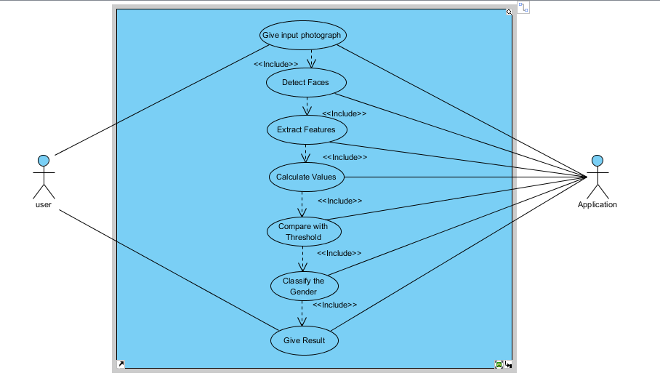
Usecase Diagram

Slide 11
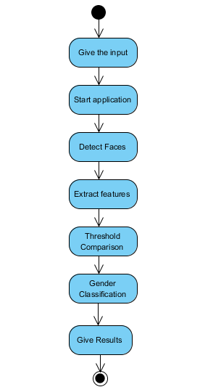
Activity Diagram

Slide 12
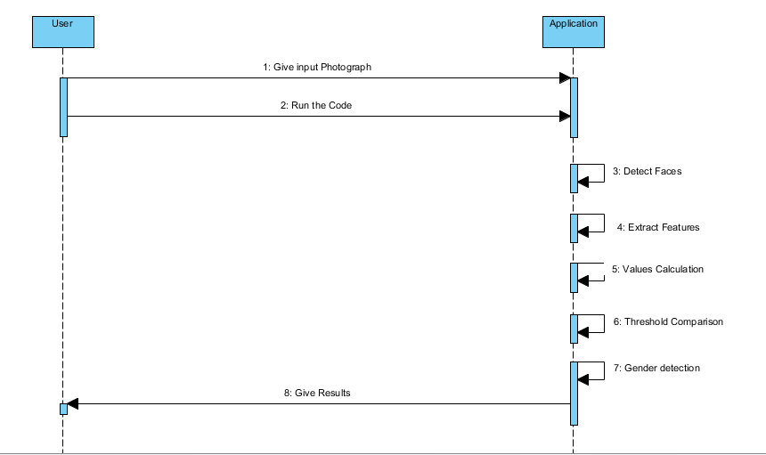
Sequence Diagram

Slide 13
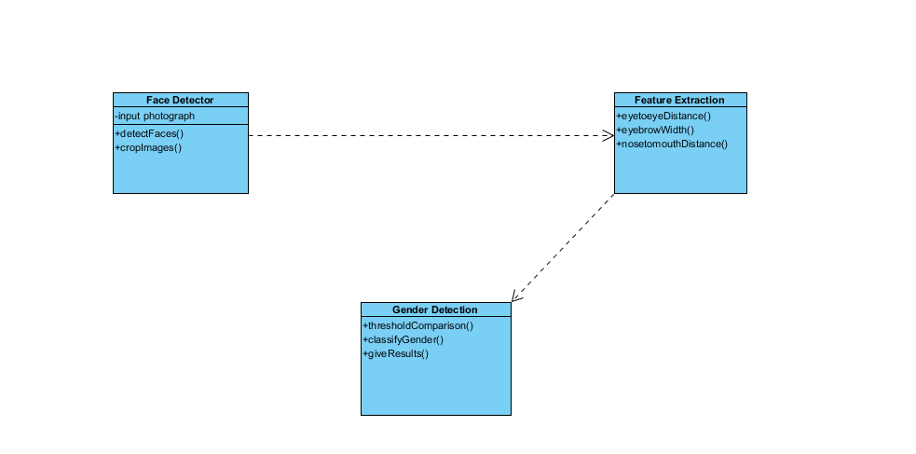
Class Diagram

Slide 14

Output ScreenShots
Figure 1: Taking Input Image Path from User

Slide 15
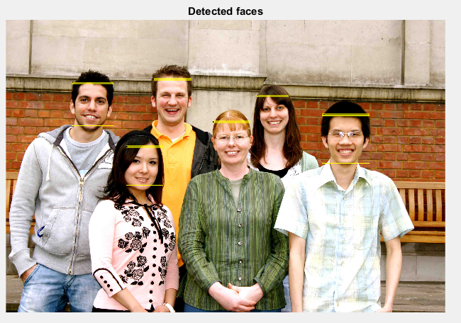
Detected faces from input photograph

Slide 16
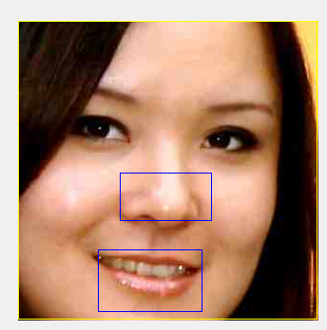
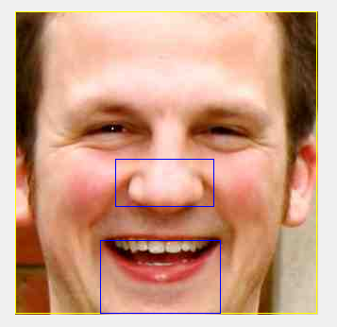
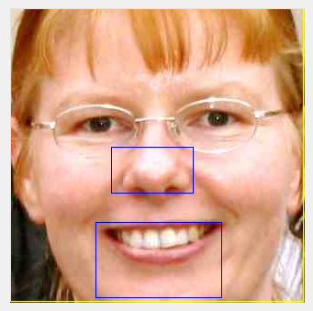
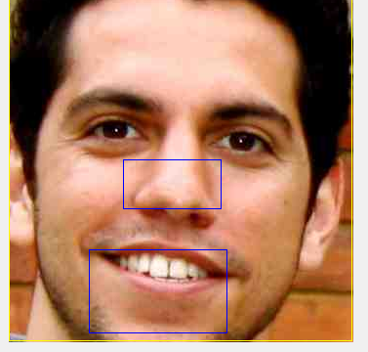
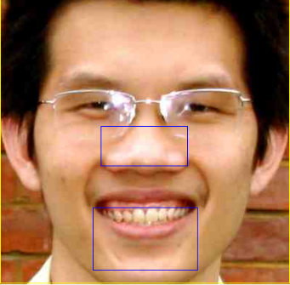
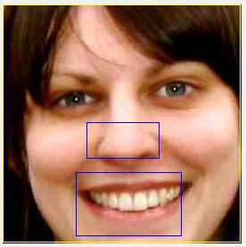
Determining Nose to Mouth Distance

Slide 17
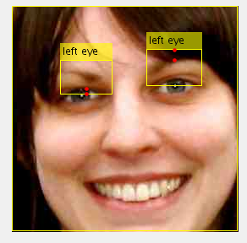
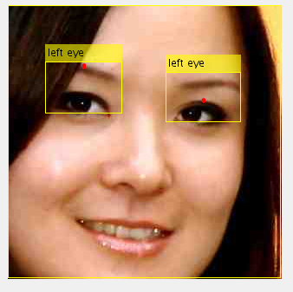
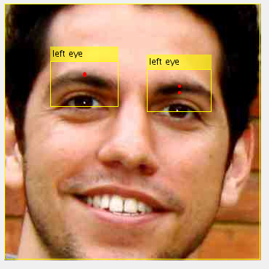
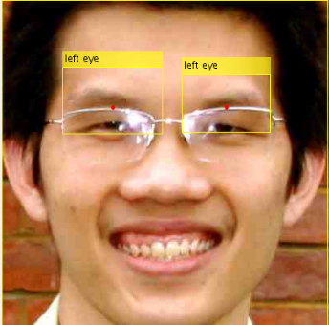
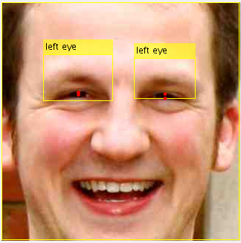
Determining Eyebrow Width

Slide 18
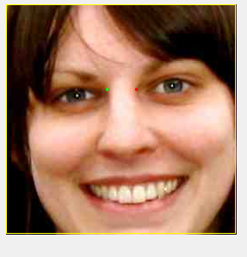
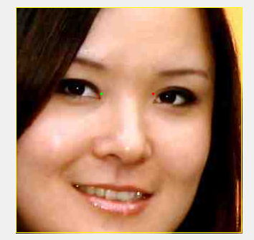
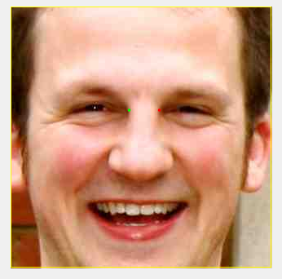



Determining Eye To Eye Distance

Slide 19
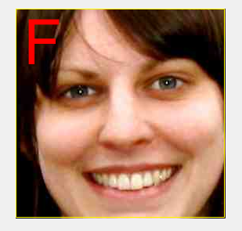
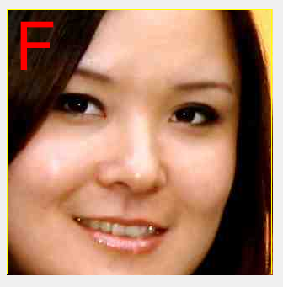
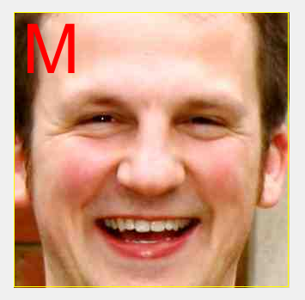



Detecting gender of each person

Slide 20
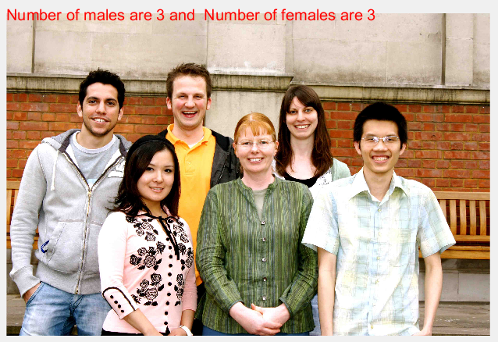
Displaying the count of males and females in given photograph

Slide 21
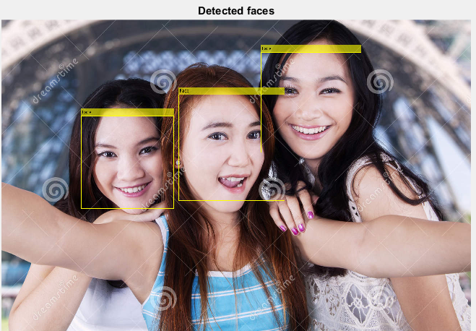
Detected faces in the given photograph

Slide 22
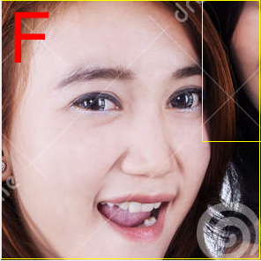
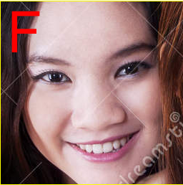
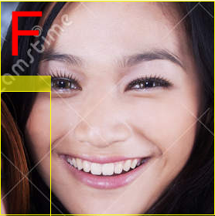
Detecting gender of each person

Slide 23
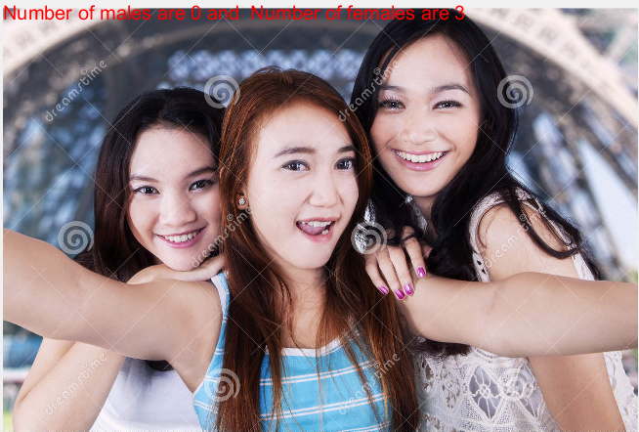
Displaying the count of males and females in given photograph

Slide 24
CONCLUSION
The emergence of high resolution digital cameras for recording of still images and video streams has had a significant impact on how communication and entertainment have developed during the recent years.
In this, we classify the gender on the basis of features. When to classify the gender: first to detect the faces in the photo, once the face is detected then to extract the features from each face by using Viola Jones Algorithm.
Then, the system searches the entire face for a match of eyebrow color and skin color using the rgb values from the color images. Once the features are extracted, then by making use of them, we classify the gender.
This application helps you to detect the gender of each individual person in the photograph. It also gives the number of males and females in the given group photograph. The results obtained can be enhanced by taking more amount of Train data.

Slide 25
REFERENCES
[1] Anushri Jaswante et al, / (IJCSIT) International Journal of Computer Science and Information Technologies, Vol. 4 (6) , 2013, “Gender Classification Technique Based on Facial Features using Neural Network”
[2] Ihsan Ullah ,Muhammad Hussain at IWSSIP 2012, 11-13 April 2012, Vienna, Austria “Gender Recognition From Face Images With Local WLD Descriptor”
[3] Andrew C. Gallagher, Tsuhan Chen Carnegie Mellon University Pittsburgh, Pennsylvania, “Understanding Images of Groups of People”

